Slide 1




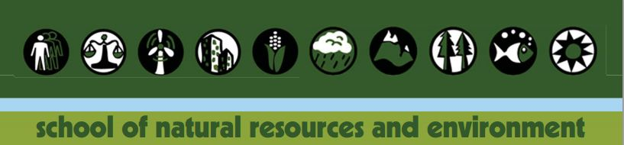
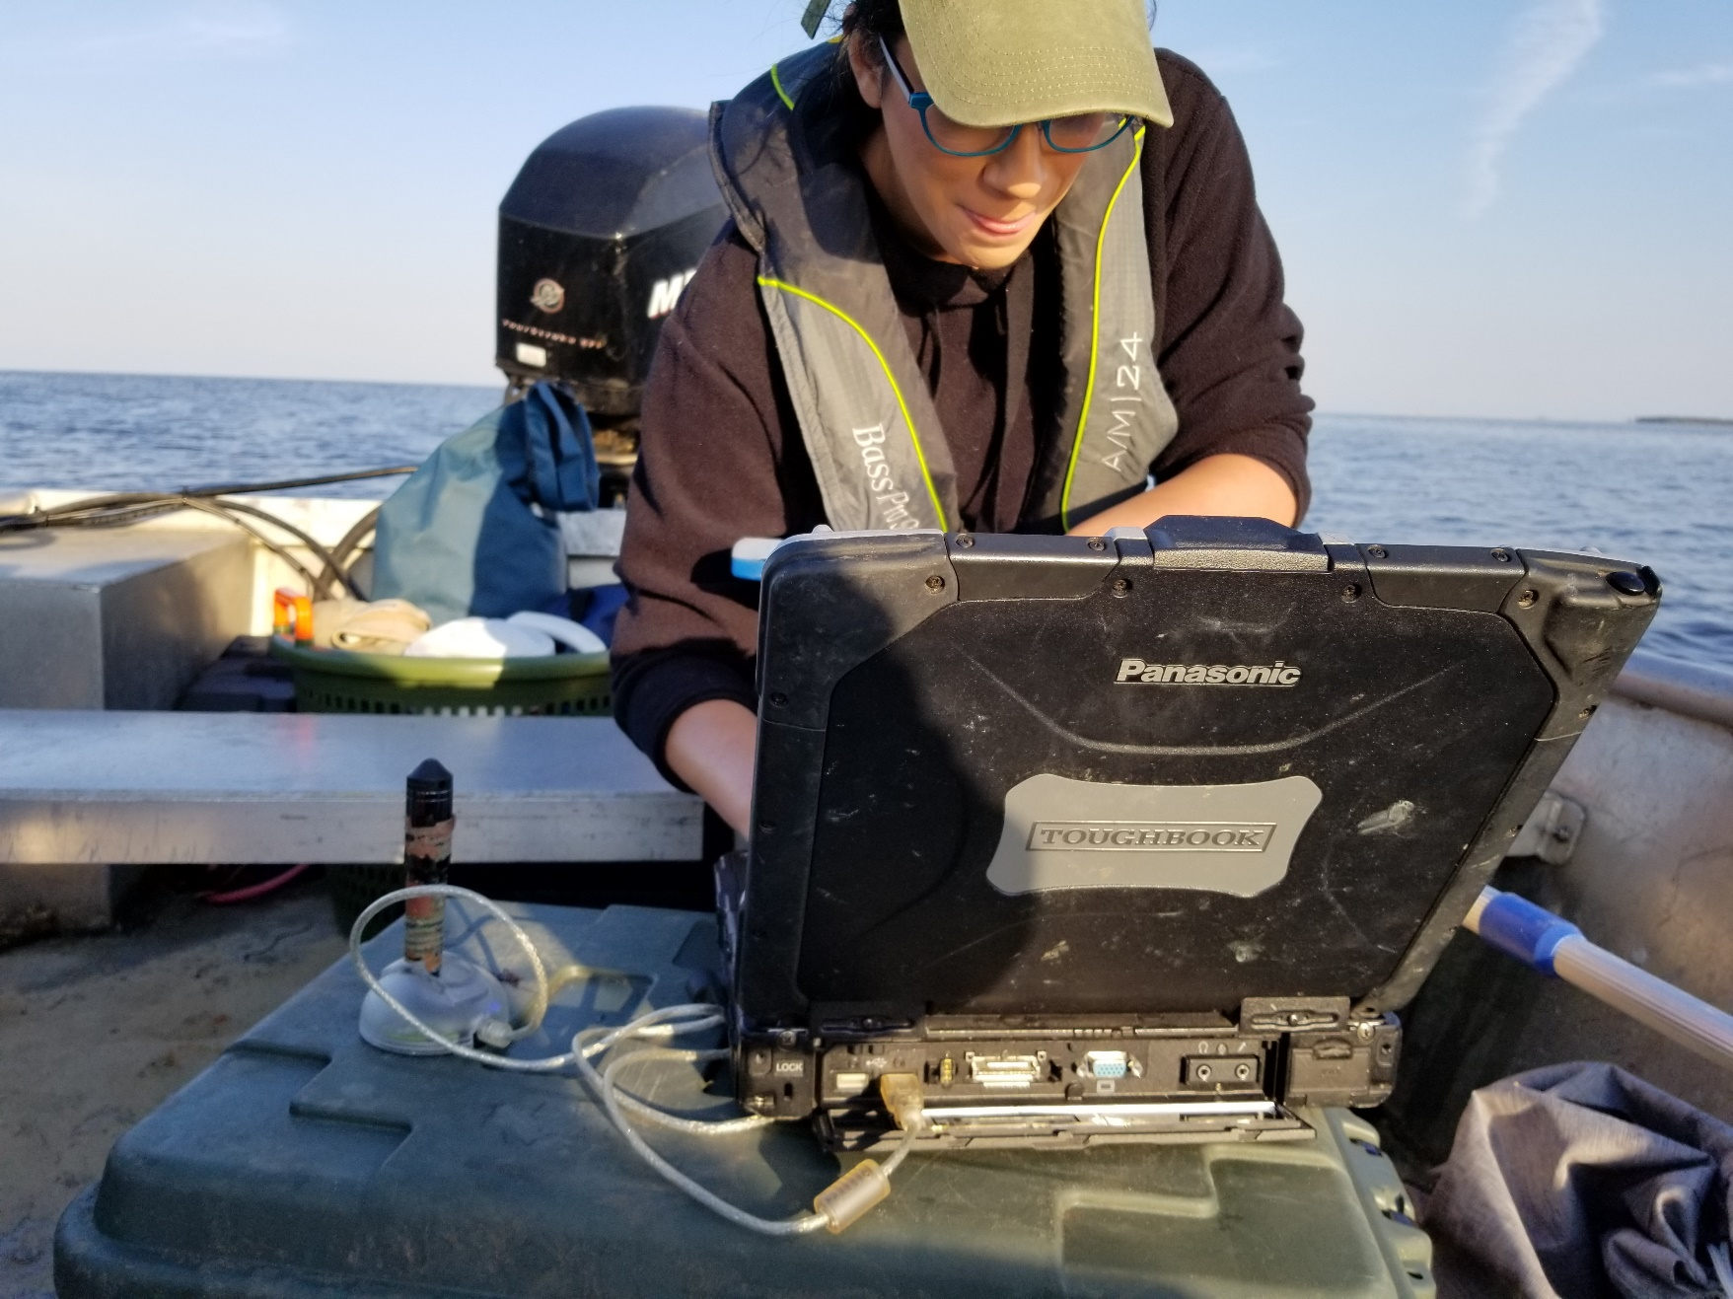
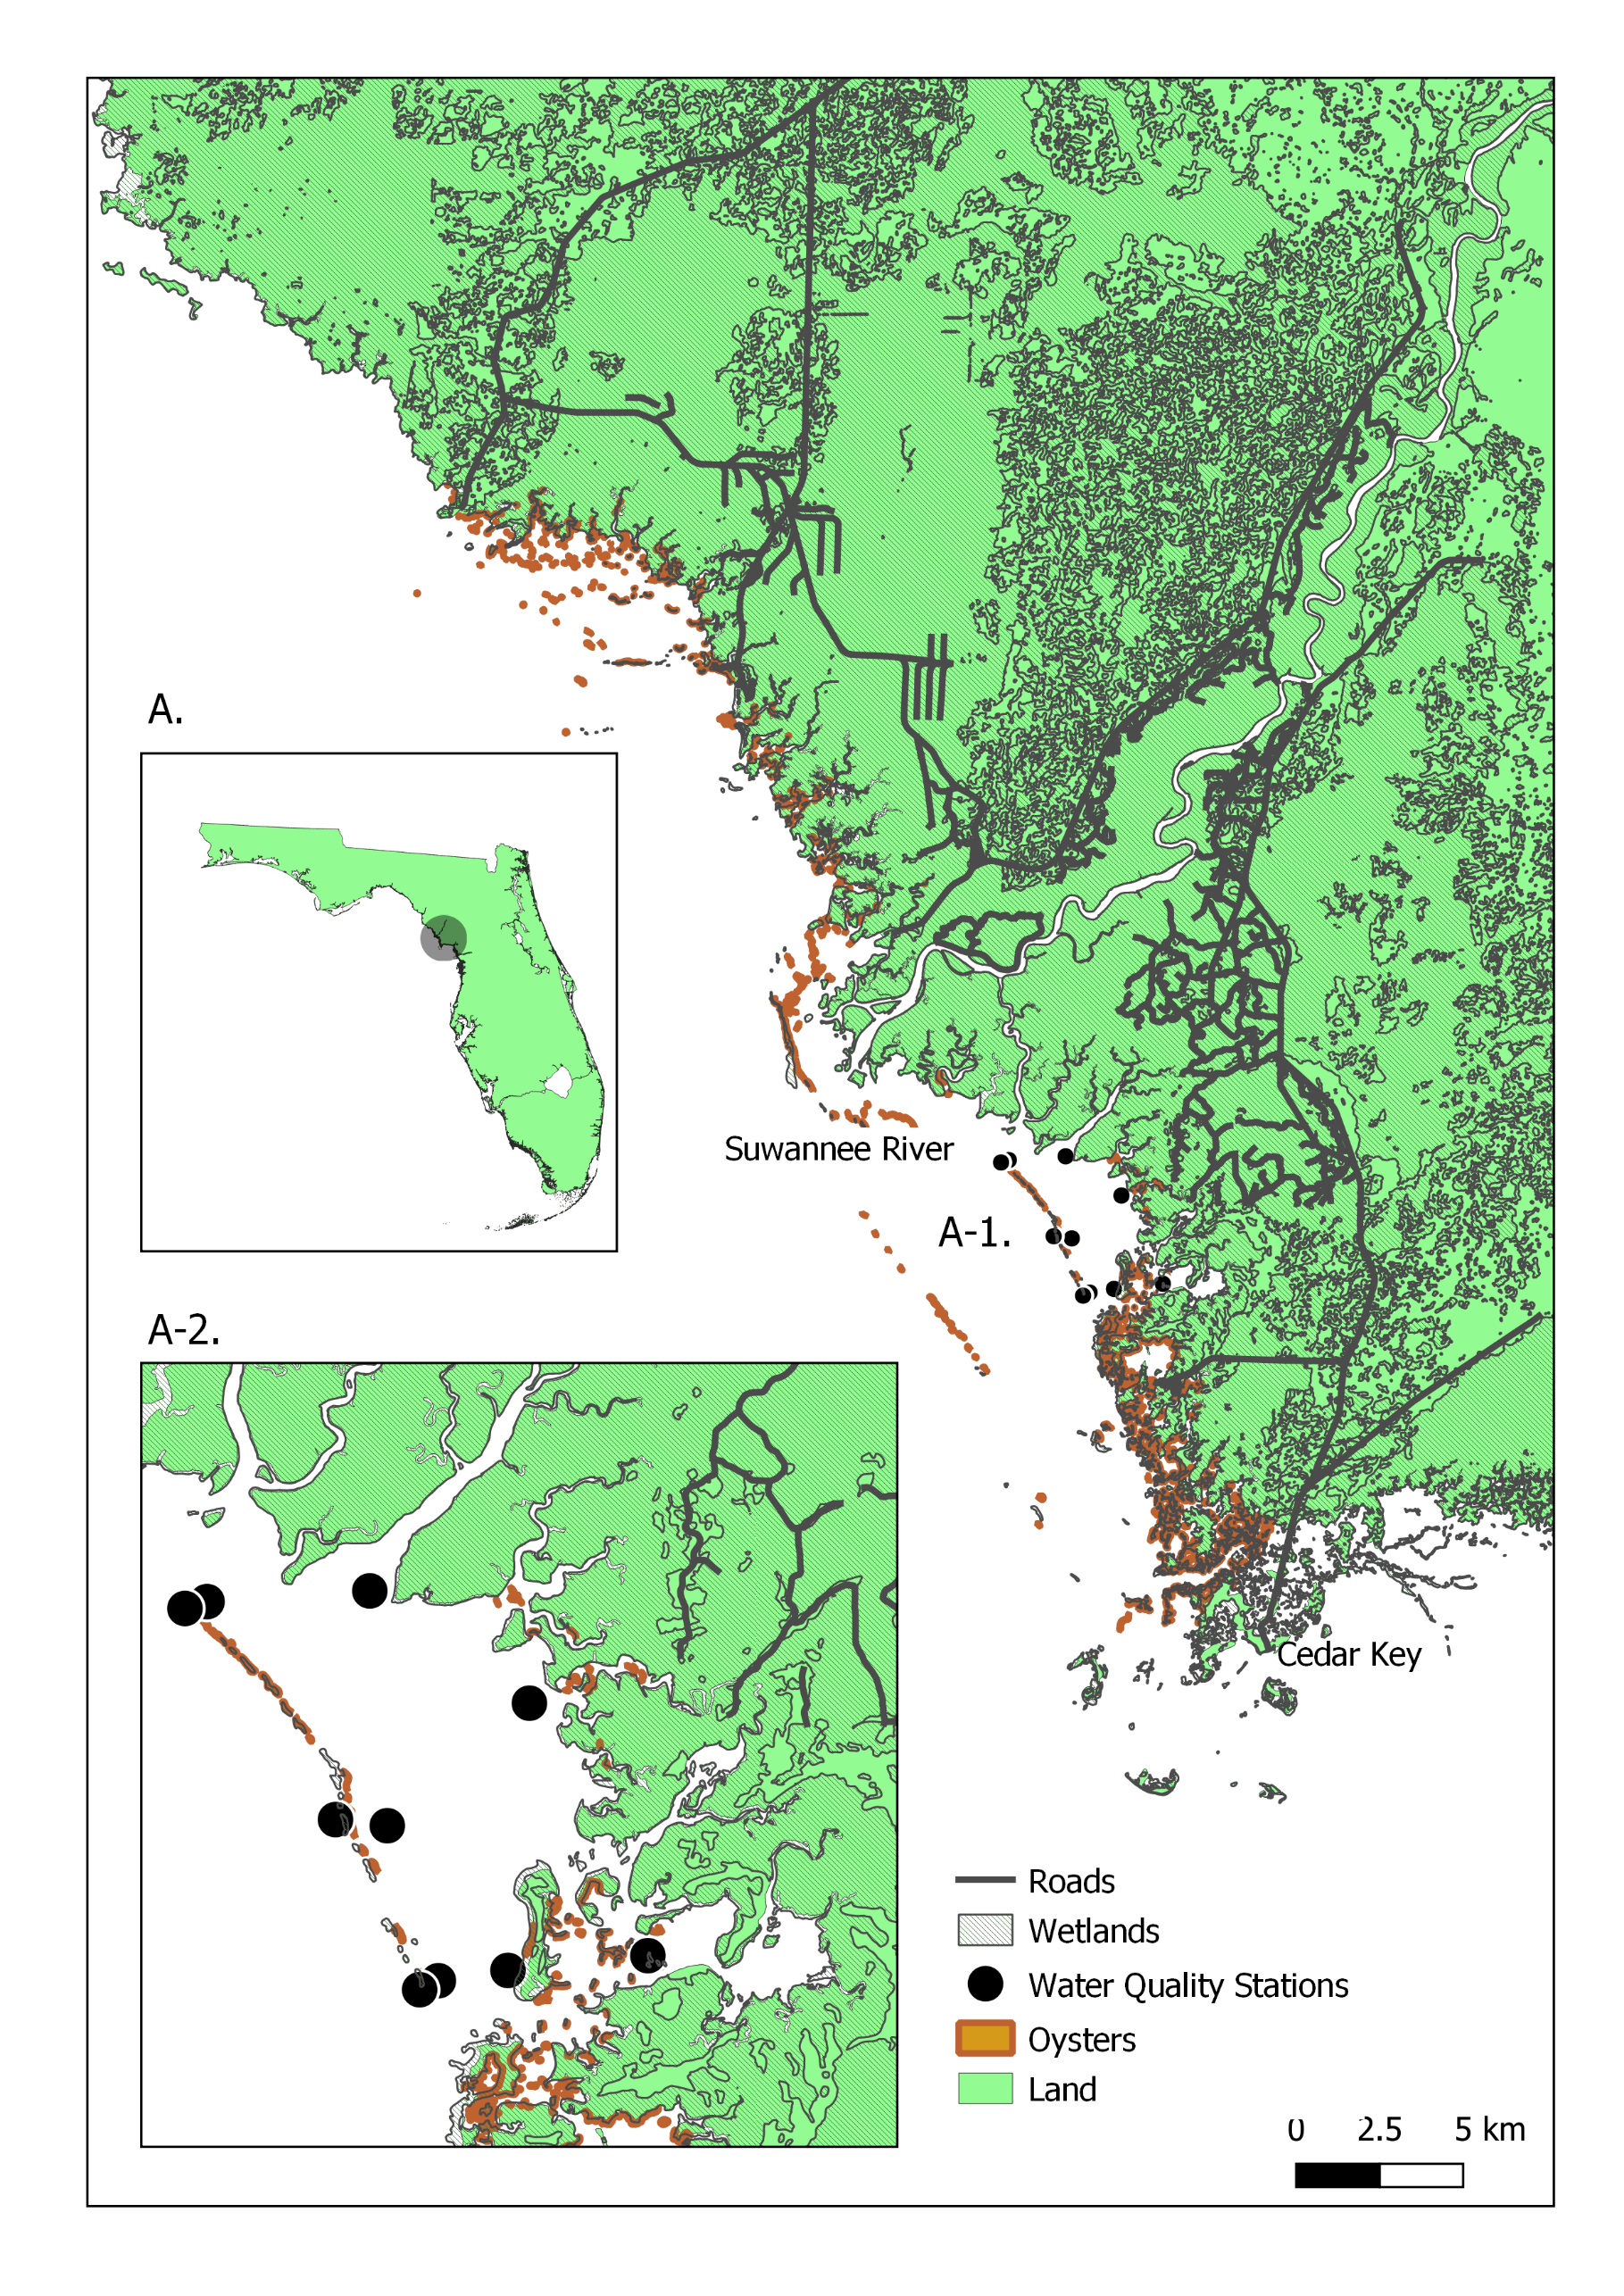
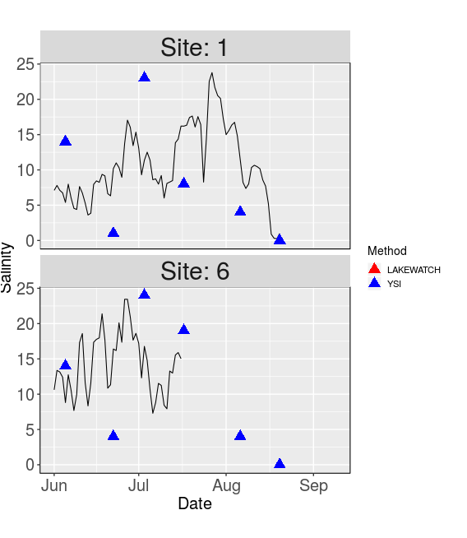
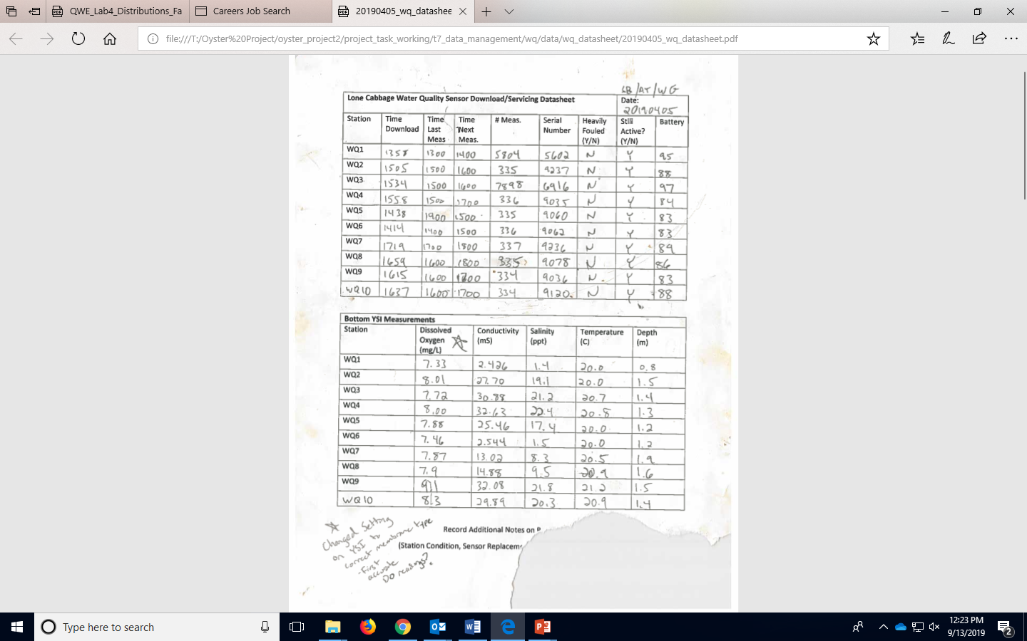
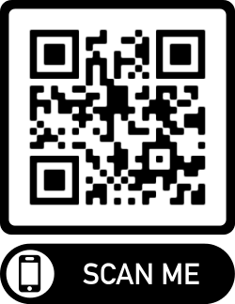

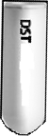
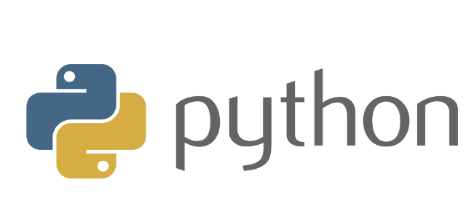

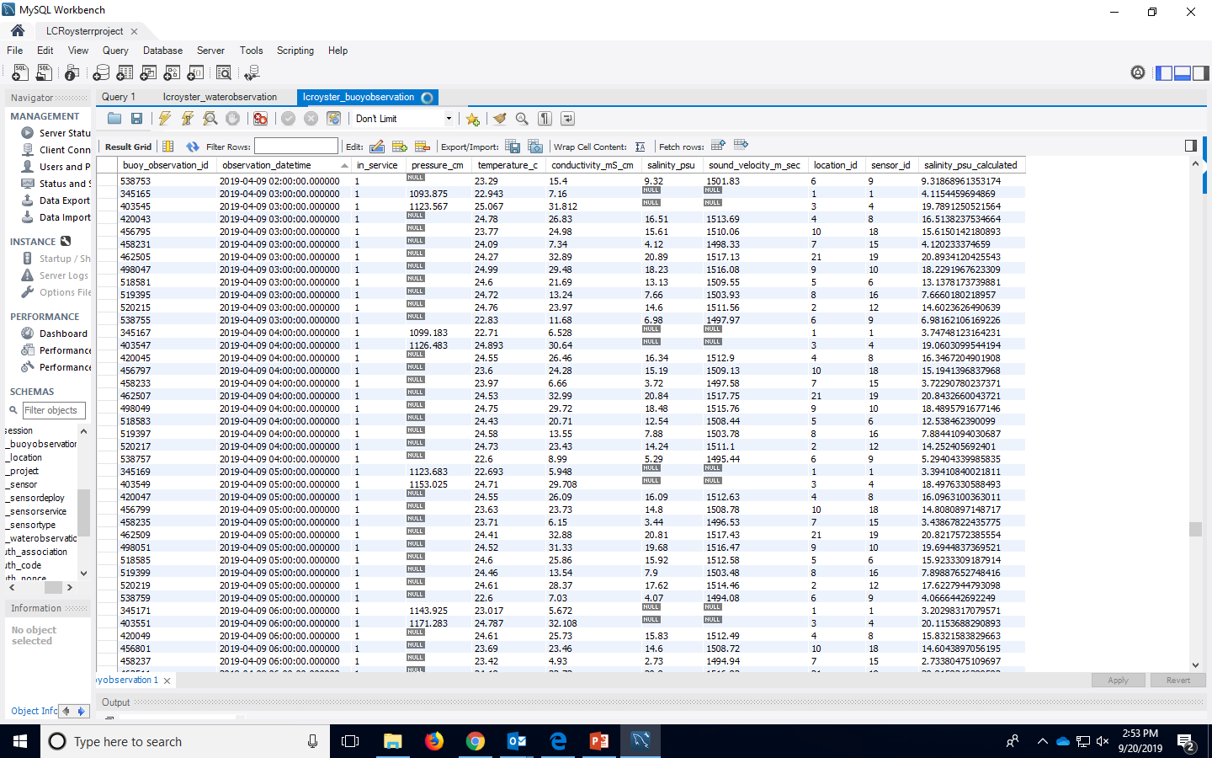
Big Changes in the Big Bend:
A Data Management Story
Authors: Melissa Moreno, Joe Aufmuth, Dr. Bill Pine
Cycle begins again with newly added data
1) Data Collection
3) Interactive Shiny App
The Interactive Shiny App allows for agencies and the public to view the results of our data collection. Updates are available within 5 business days of water quality service trip.
Promoting Lone Cabbage Reef oyster recovery and estuarine conditions
Living data from sensors and field observations
Modern data workflow tools
Minimize errors to inform ongoing restoration
2) Database
Acknowledgments:
Dan Maxwell - Associate University Librarian at the University of Florida
Plato Smith - Data Management Librarian at the University of Florida
Robert Phillips - Information Technologist, George A. Smathers Libraries at the University of Florida
Peter Fredrick - Research Professor in the Department of Wildlife Ecology and Conservation at the University of Florida
Steve Beck - Research Coordinator for Lone Cabbage Reef Restoration Project at the University of Florida
Sarah Meyer - Health Sciences Librarian at the University of Florida

